Slide 1

Project on National Data Portals in Samoa and Fiji Workshop 2 Experience Sharing and SDMX/.Stat Suite Tools 27-31 January 2025 Suva, Fiji
FMR Workbench: Data Structures Definitions, Dataflows, and Content Constraints

Slide 2


Learning objectives
At the end of this session, you will be able to:
Create, edit, and delete DSDs
Create, edit, and delete DFs
Create, edit, and delete Content Constraints

Slide 3
Outline
Datastructures Definition
Wizard
Extraction from CSV
Deletion
Dataflows
Wizard
Deletion

Slide 4
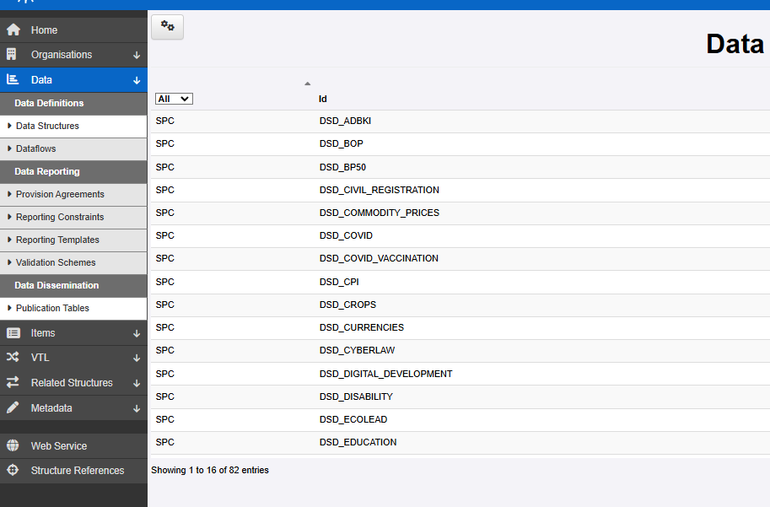
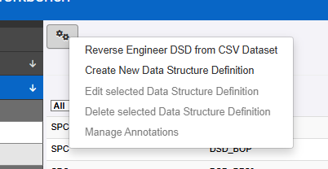
Data Structure Definition creation Wizard

Slide 5
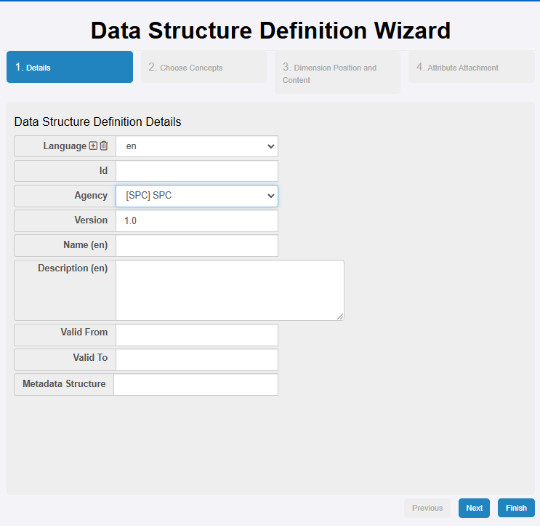
Data Structure Definition creation Wizard
Process is very similar to what we have seen for Concept Scheme and Codelists
It requires having defined already the “building blocks” (Concepts, Codes, Categories, …)
Multilingual is a possibility
Maintaining a coherent naming is very important

Slide 6
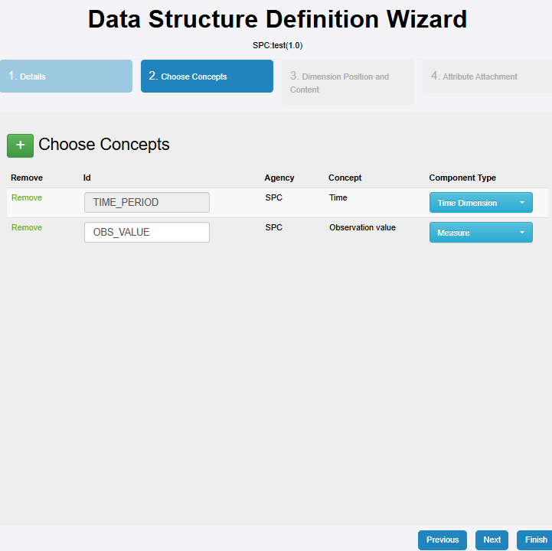
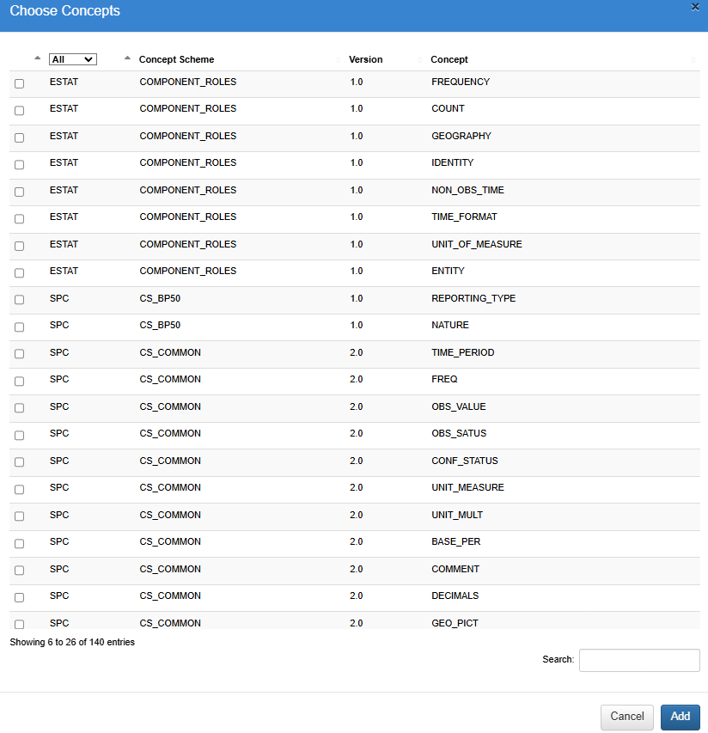
Data Structure Definition creation Wizard
1. Pick concepts to include

Slide 7
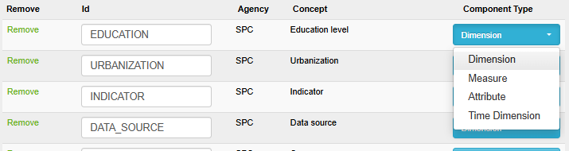
Data Structure Definition creation Wizard
Pick concepts to include
Define their (SDMX) role

Slide 8
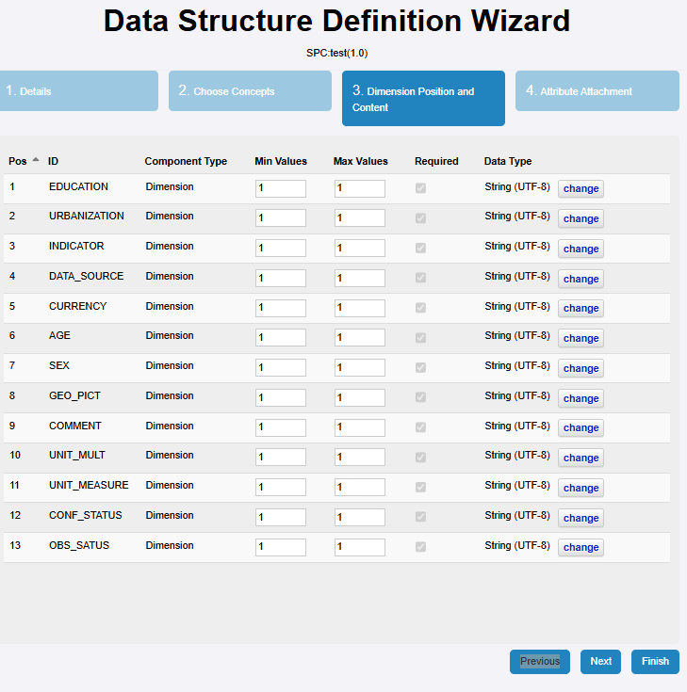
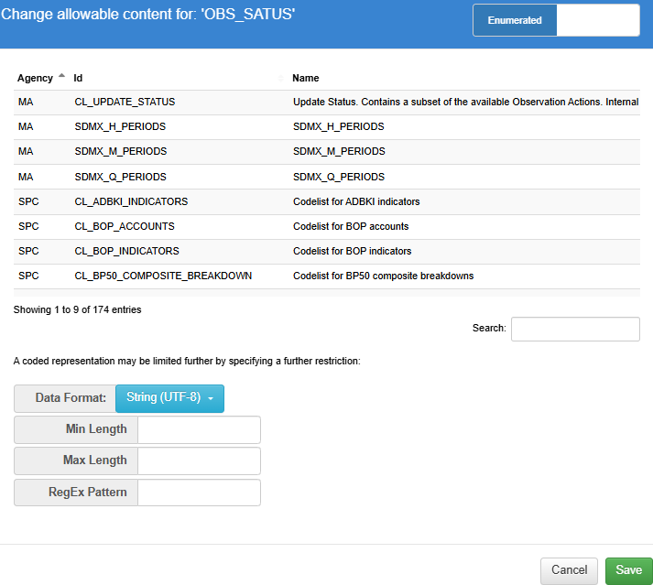
Data Structure Definition creation Wizard
Pick concepts to include
Define their (SDMX) role
(optional) set constraints

Slide 9
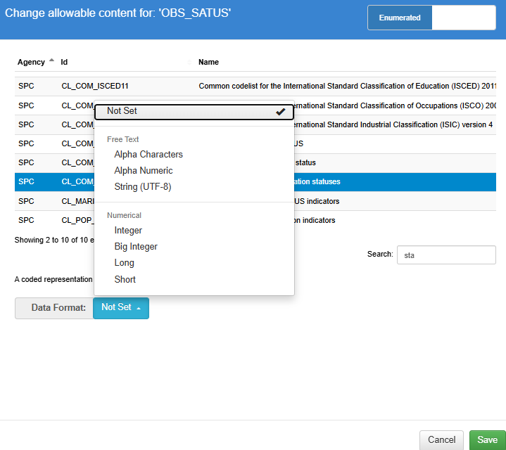
Data Structure Definition creation Wizard
Pick concepts to include
Define their (SDMX) role
(optional) set constraints

Slide 10
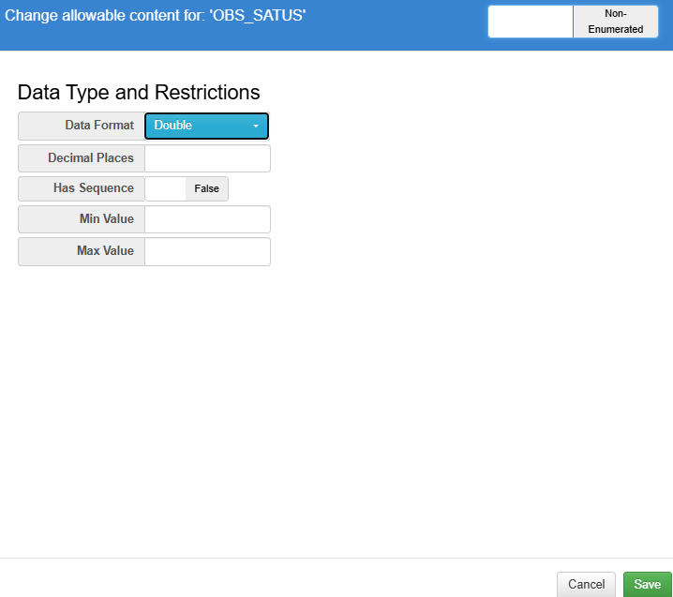
Data Structure Definition creation Wizard
Pick concepts to include
Define their (SDMX) role
(optional) set constraints
can be very detailed

Slide 11
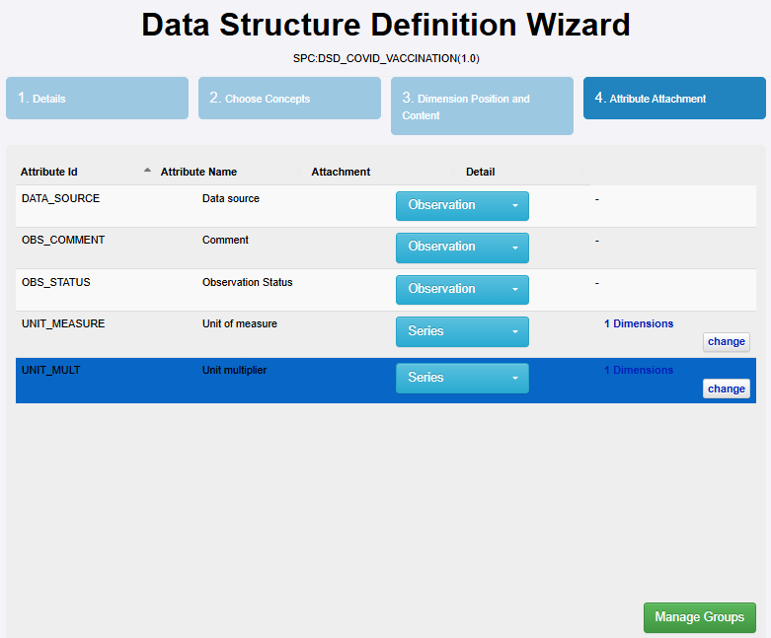
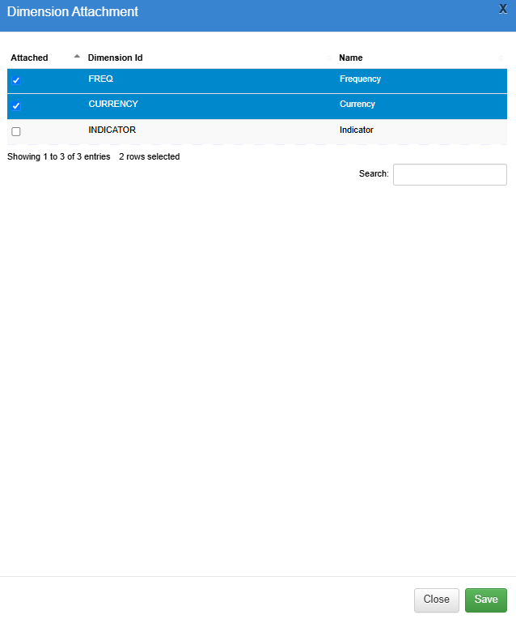
Data Structure Definition creation Wizard
Pick concepts to include
Define their (SDMX) role and position
Attach attributes to the right level
(optional) you can also create groups of observations

Slide 12
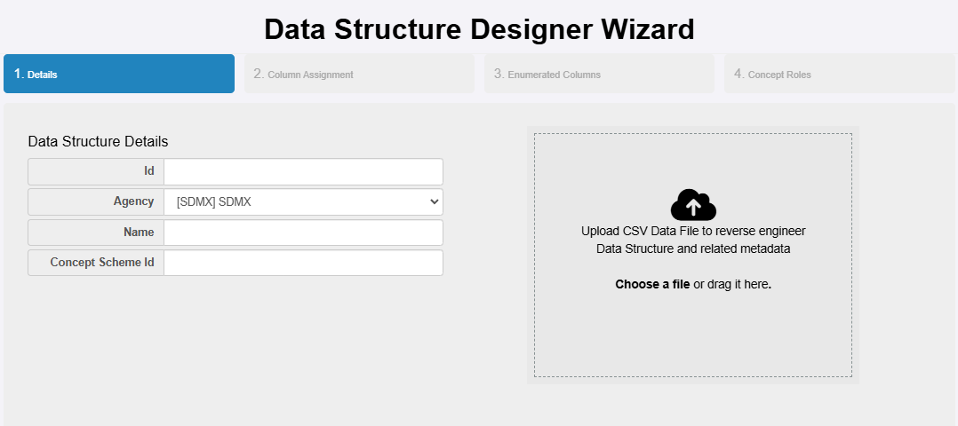
Data Structure Definition extract from csv
CSV must be comma separated (use “,” as delimiter)

Slide 13
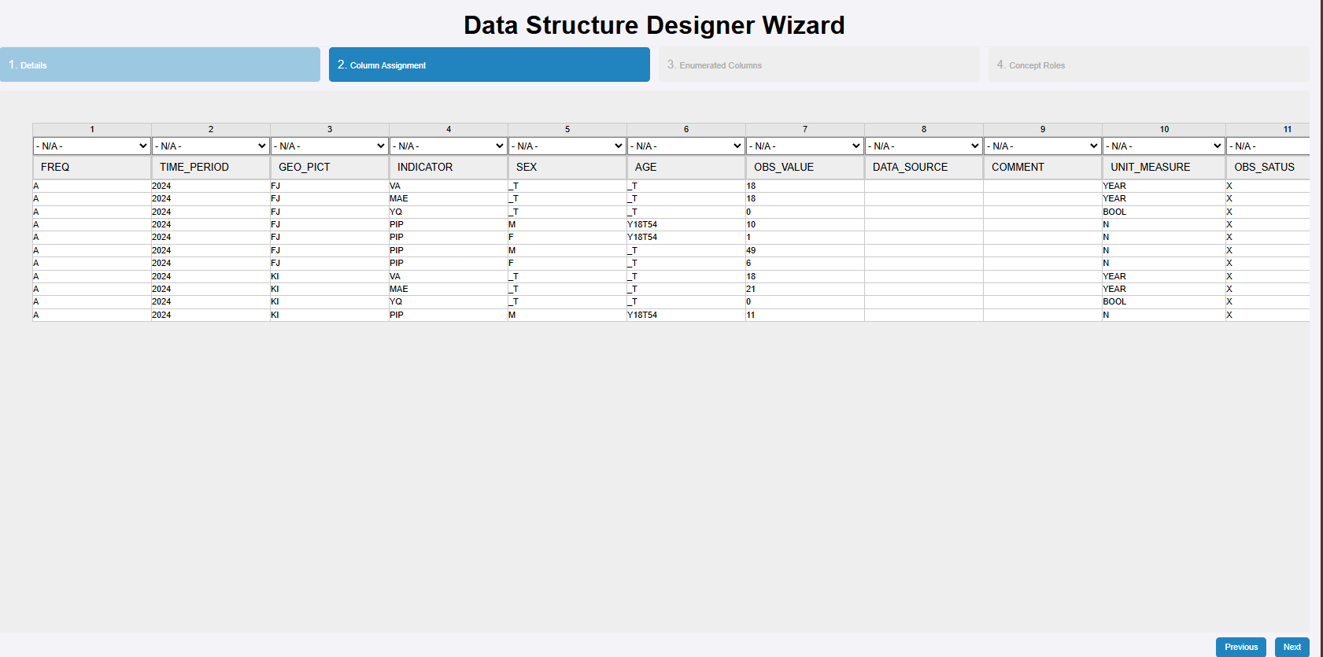
Data Structure Definition extract from csv
Check data and columns are loaded properly
Specify (by column) whether data is expressed in as an Id or a name (i.e.g, the short label or the descriptive name)
Define their format: are the values in the columns enumerated (they use a codelist), datetime, string?
Importer can’t see what is not there (all cases for future data should be already present in the csv)

Slide 14
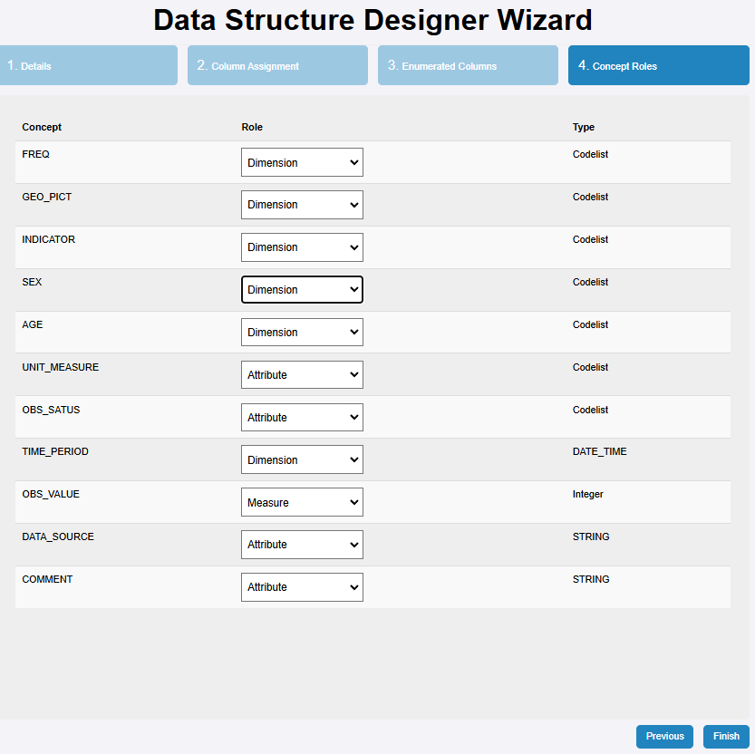
Data Structure Definition extract from csv
Check data and columns are loaded properly
Specify (by column) whether data is expressed in as an Id or a name (i.e.g, the short label or the descriptive name)
Define their format: are the values in the columns enumerated (they use a codelist), datetime, string?
Define (SDMX) roles of concept

Slide 15
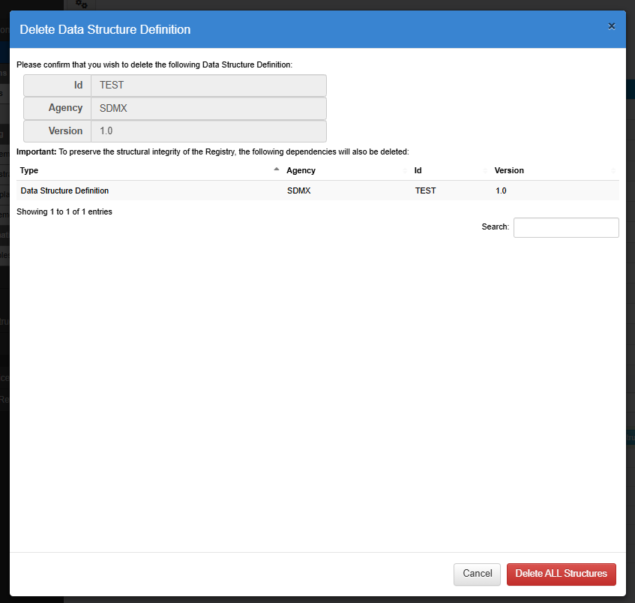
Data Structure Definition Delete
Usual warning applies (e.g., you can’t delete something if there are dependencies)

Slide 16
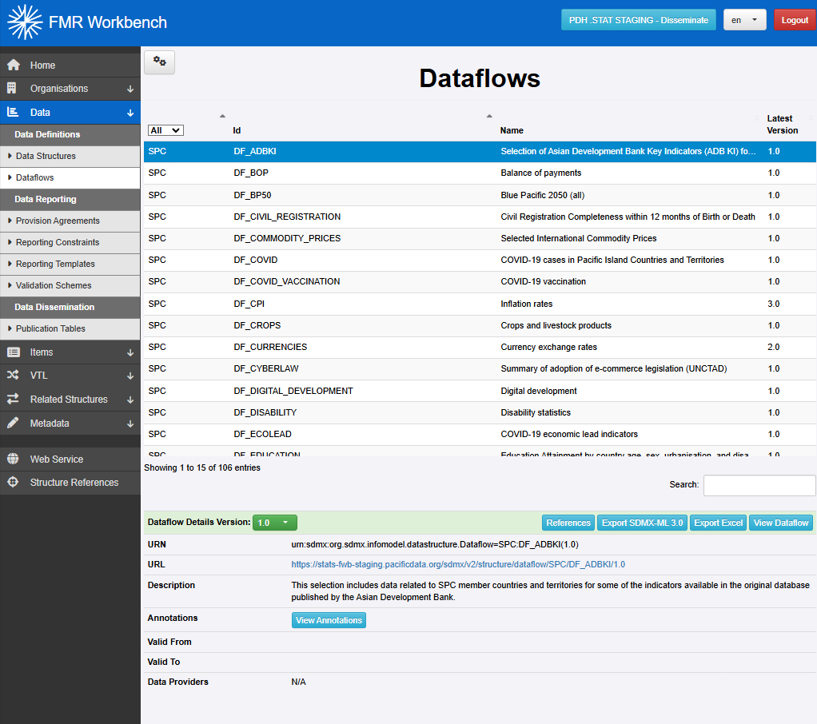
Dataflows Creation Wizard
Creation Wizard for Dataflows is the most simple (we have done most of the work already!)
Data constraints and annotations in next session

Slide 17
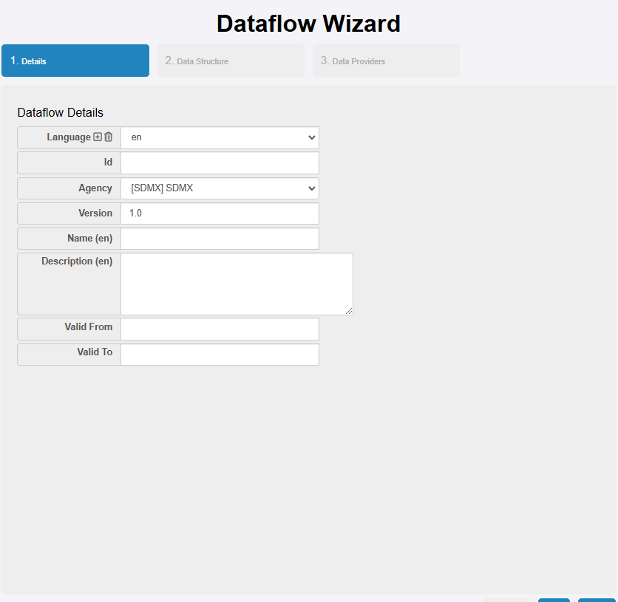
Dataflows Creation Wizard
Define details
Pay attention to Name (it will be visible to public)
Provide a good description

Slide 18
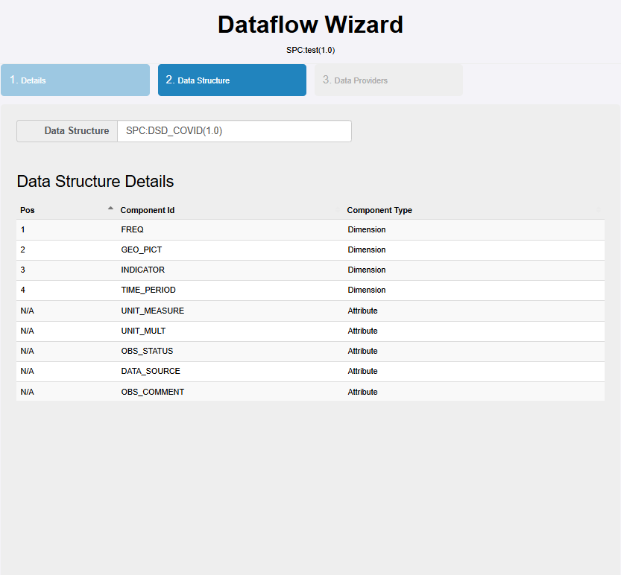
Dataflows Creation Wizard
Define details
Pick a Data Structure to populate dataflow
Wizard will show you a brief summary of structure to make sure you got the right one

Slide 19
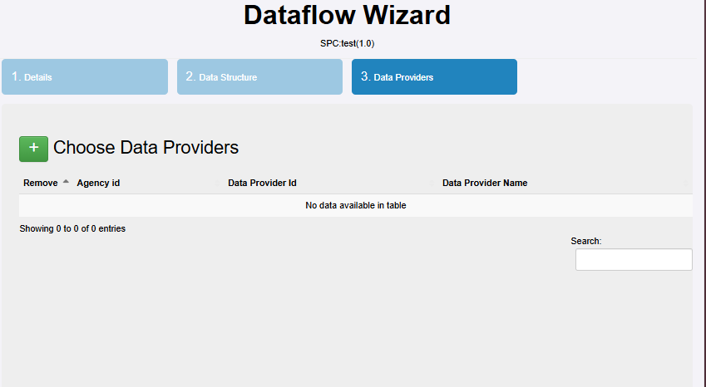
Dataflows Creation Wizard
Define details
Pick a Data Structure to populate dataflow
(optional) choose a data provider a provider agreement should be in place

Slide 20
Exercise
Consider Fiji and Samoa published population data (for example: Fiji, Samoa)
Design and create a Datastructure Definition and Dataflows to recreate one or more of those tables.
Validate each other artefacts, or edit them otherwise.

Slide 21
Discussion and Q&A

